Slide 1


Welcome to
CS341
Visual Programming

Slide 2
Instructor – Bassem Abd-El-Atty
Classroom: 1
Lecture : Mondays 9:00 AM – 12:00 PM
Office: Third floor
Office Hours:
E-Mail: bassem.abdelatty@fci.luxor.edu.eg

Slide 3
Course Description
Graphical user interface (GUI), review of concepts, and anatomy of a windows program using different languages. Available developing tools. Keyboard and mouse input, menus creating, adding menus to programs. Dialog boxes: buttons, text, list boxes, grids and spreadsheets. Graphics files and file handling. Multiple documents interfaces and views (MDI). Exception Handling and Debugging.

Slide 4

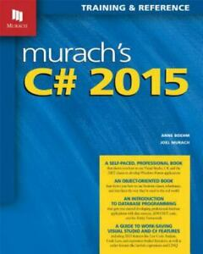
Textbook

Slide 5
Chapter 1

Slide 6
Objectives

Slide 7
Objectives (cont.)

Slide 8
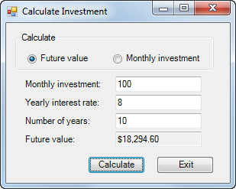
A Windows Forms application running on the desktop

Slide 9
Common types of .NET applications

Slide 10
Visual Studio 2015 Editions

Slide 11
Programming languages supported by Visual Studio 2015

Slide 12
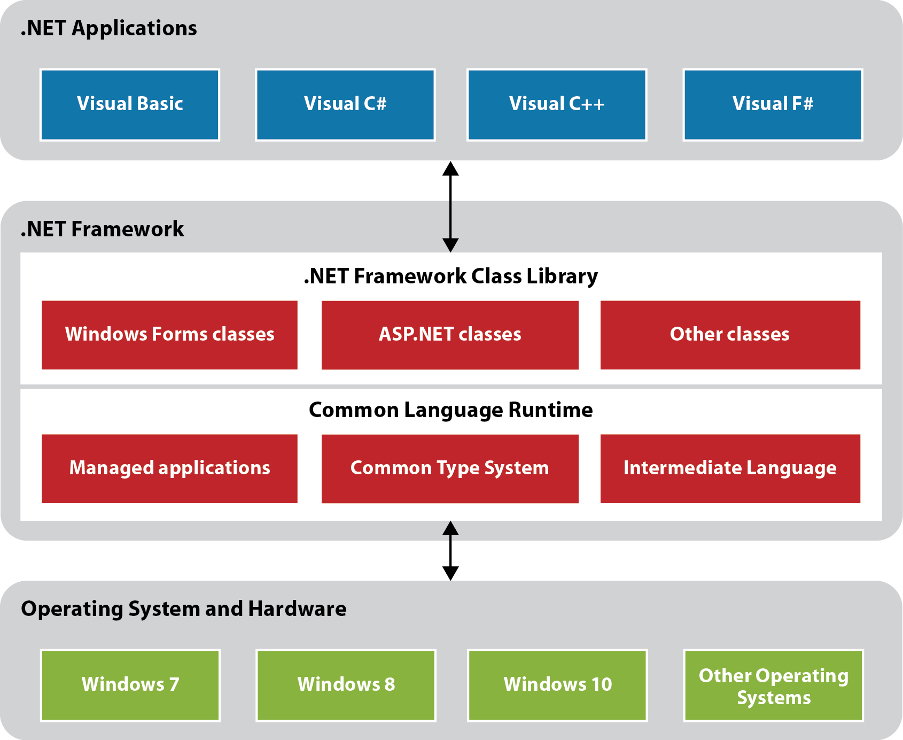
The .NET Framework

Slide 13
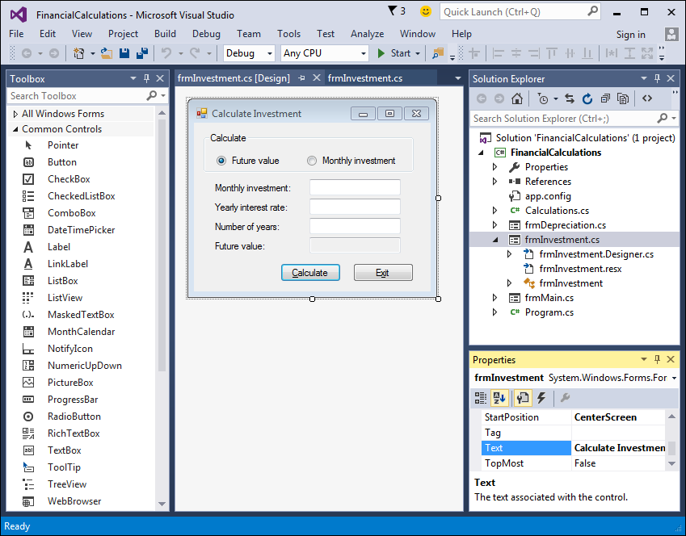
The Visual Studio IDE

Slide 14
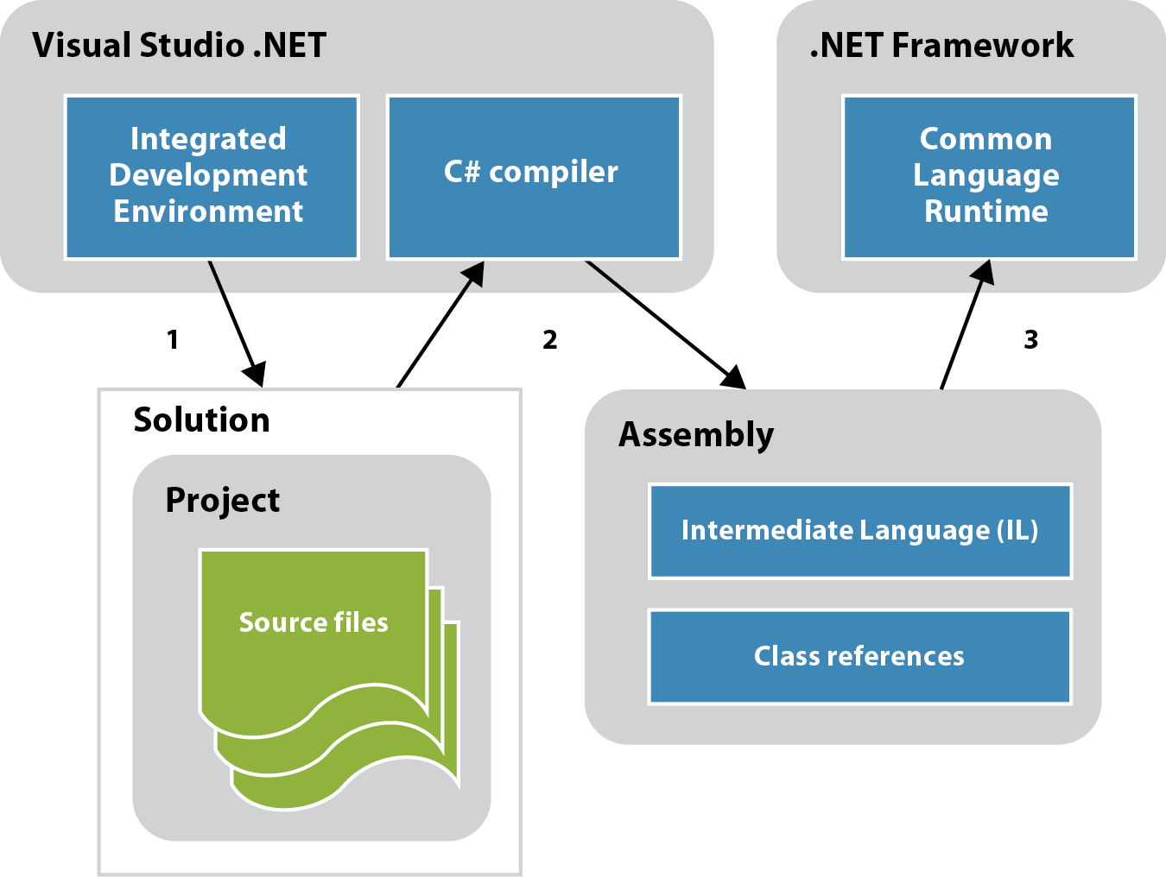
How a C# application is compiled and run

Slide 15
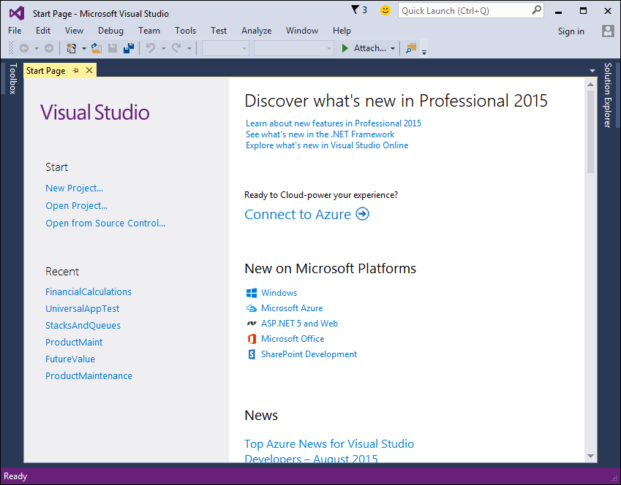
The Visual Studio Start Page

Slide 16
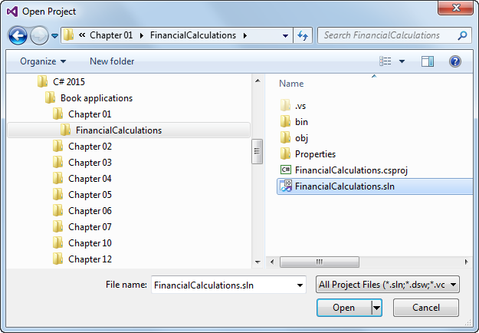
The Open Project dialog box

Slide 17
Project and solution concepts

Slide 18
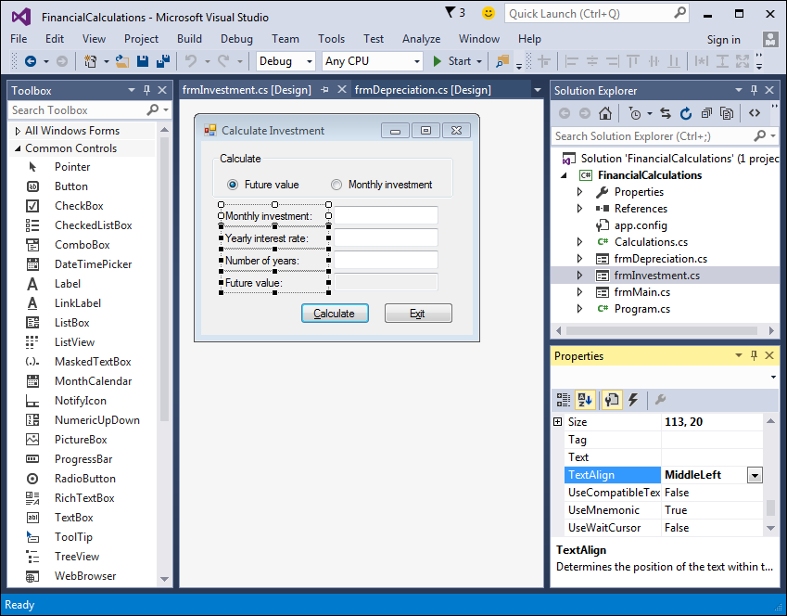
The Form Designer window of Visual

Slide 19
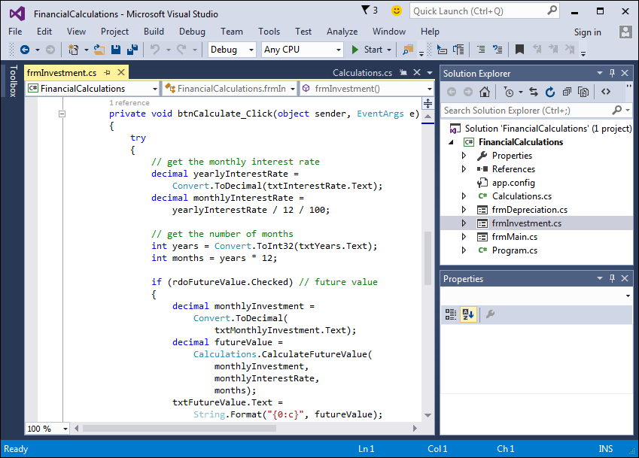
The Code Editor window of Visual

Slide 20
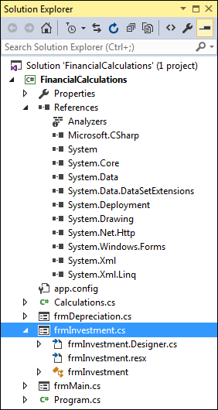
The Solution Explorer

Slide 21
Project files

Slide 22
Project files (cont.)

Slide 23
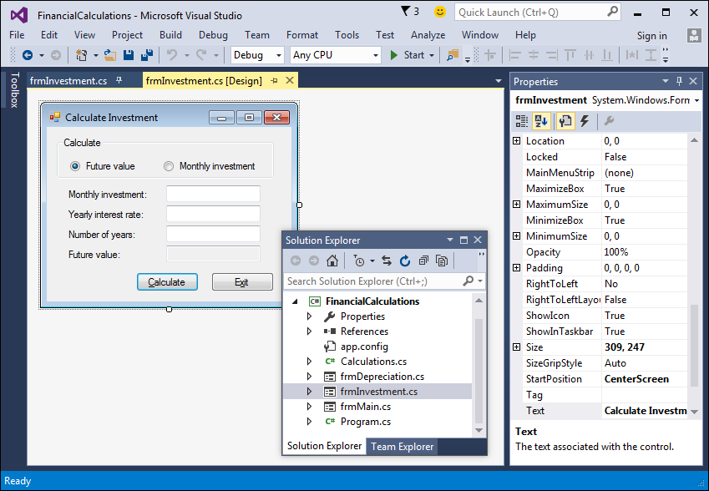
Two floating windows, a hidden window, and a pinned window

Slide 24
How to rearrange windows

Slide 25
How to rearrange windows (cont.)

Slide 26
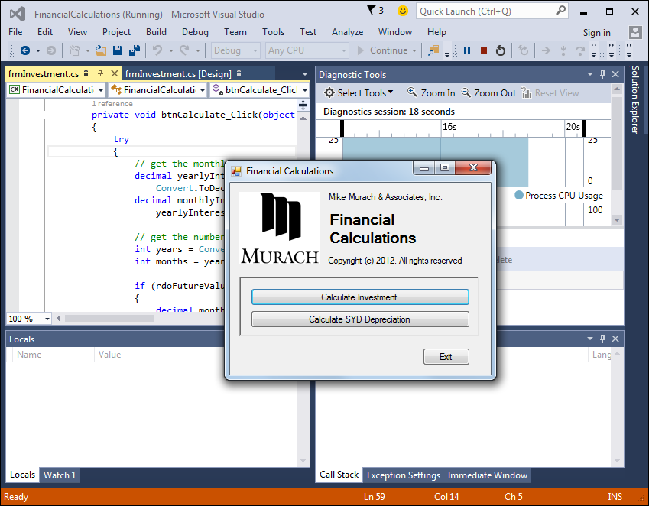
The form that’s displayed when the Financial Calculations project is run

Slide 27
How to build a project without running it

Slide 28
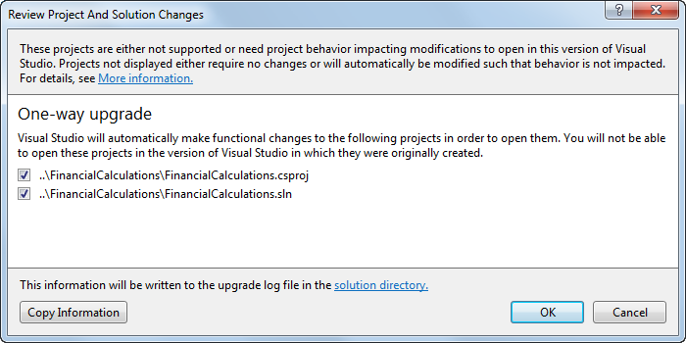
The dialog box for upgrading a project to Visual Studio 2015

Slide 29
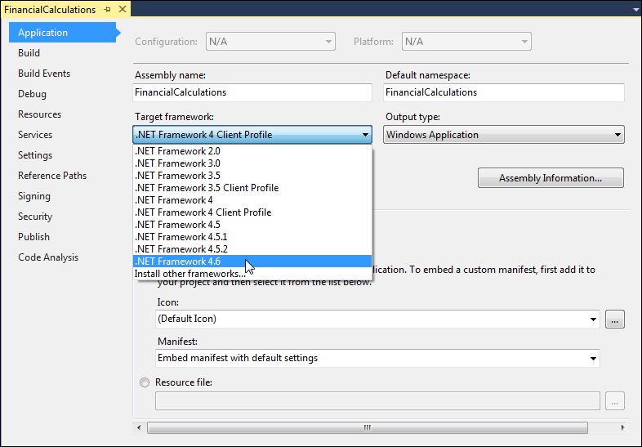
The application properties for a project

